Slide 1


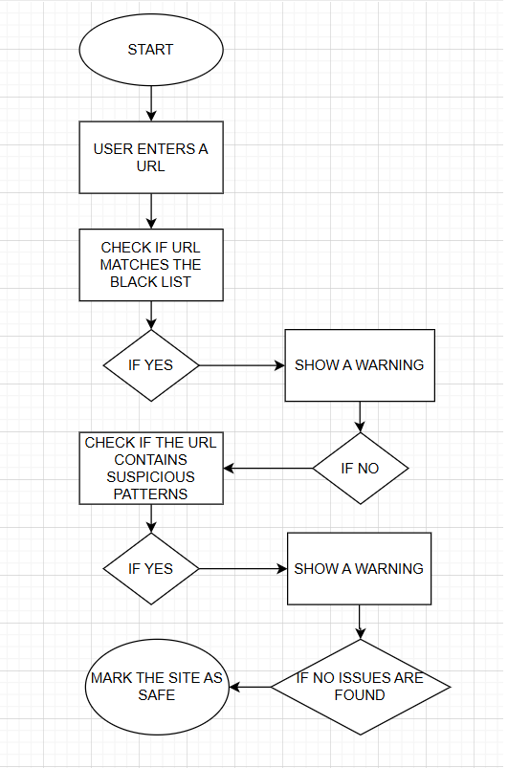

Phishing Detection Extension - Proof of Concept.
Spring 2025 - Cybersecurity Senior Design Project.
Ezekiel Garcia, Jonathan Iglesias,
Giovani Labrador, Tristan Liebenberg, Eyaan Syed
Professor: Dr. Sadjadi
Introduction
Phishing attacks are among the most destructive and widespread cyber threats, targeting individuals and enterprises worldwide.(1) By imitating trusted entities, these attacks aim to steal sensitive data such as passwords and financial information, causing significant financial losses and data breaches.(3) To address these challenges, this project introduces a Java-based phishing detection system that flags phishing emails through keyword analysis. By identifying common phishing patterns within email content,(2) the system provides a simple yet effective method for distinguishing legitimate emails from phishing attempts. Initial testing has shown promising results, demonstrating its potential to enhance user security and mitigate phishing threats. The project also explores the evolution of phishing tactics, modern detection techniques—including machine learning and AI—and the critical role of advanced phishing detection in reducing cyber risks. With its practical approach and focus on improving cybersecurity, this proof of concept aims to offer insights and strategies to combat phishing attacks and minimize their impact.
Methodology
The following guidelines will outline the steps taken to develop and implement the Phishing Detection Extension system. The frontend of the Phishing Detection tool is built as a single-page HTML application with a clean, tab-based interface. It allows users to either input suspicious URLs or paste the full text of a potentially harmful email. The design emphasizes simplicity, accessibility, and responsiveness using modern HTML and CSS. The app offers two scanning features: one that accepts direct URLs and another that extracts and analyzes links from email content. JavaScript handles user interaction, extracting URLs, making asynchronous requests to the backend, and rendering threat reports in real-time. This interface showcases a realistic user experience that mimics how a browser extension could proactively warn users about phishing links before they engage with them. The package.json file defines the project as a Node.js application that acts as a secure proxy between the frontend and third-party threat intelligence services like VirusTotal and AbuseIPDB. It lists essential dependencies including: • Express (for building the API server), • Axios (for making HTTP requests), • CORS (for enabling safe frontend-backend communication). It also includes a start script (node server.js) for ease of execution and testing. This setup ensures the backend environment is portable, secure, and easy to deploy or maintain — even in a proof-of-concept phase. The server is built using Express.js and plays the critical role of securely handling scan requests. It exposes two main API endpoints: • /api/virustotal: Accepts a URL, submits it to the VirusTotal scan API, waits briefly, and retrieves the final analysis. It returns the number of antivirus engines that flagged the URL as malicious or suspicious, along with a link to the full report. • /api/abuseipdb: Accepts a domain, resolves it to an IP address, and checks the IP against AbuseIPDB to determine its abuse confidence score and associated metadata (like ISP and country). The backend is designed to hide API keys from the client, ensuring security. It also supports cross-origin requests from the frontend and serves static files from a public directory. A fallback route ensures that the interface loads even if a user navigates directly to an undefined path.
System Design
 | The project is designed to employ a rule-based approach to phishing detection, focusing on simplicity and practicality. The main components of the system include: 1. Input Module: Accepts user-provided emails or URLs for analysis. 2. Detection Module: Implements predefined rules to analyze emails and URLs based on: Keywords (e.g., "verify", "update"). URL patterns (e.g., excessive subdomains, HTTP protocols). Structural inconsistencies (e.g., long or unusual URLs). 3. Output Module: Flags potentially phishing threats by providing clear notifications or quarantining suspicious emails/URLs.
Results & Conclusion
The Phishing Detection Extension prototype demonstrated excellent accuracy, reliably distinguishing between "phishing" and "legitimate" emails with minimal errors. Its performance during testing field highlights its potential as a reliable tool for threat detection and offers valuable insights into combating phishing attacks, contributing to advancements in the cybersecurity. The successful demonstration of this proof of concept underscores its ability to mitigate phishing threats and protect sensitive information from cybercriminals. Furthermore, this project establishes a foundation for future research aimed at addressing emerging cybersecurity challenges. By continuously updating keywords and patterns, the extension can adapt to evolving phishing tactics and maintain its effectiveness over time, ultimately enhancing the security of individuals and organizations.
Objectives
The primary objective of this project is to develop a proof of concept for a phishing detection extension that enhances cybersecurity measures by demonstrating a simple yet effective method to distinguish legitimate emails from phishing attempts. This prototype will analyze email content to identify common phishing keywords and patterns. Additionally, the project aims to test this proof of concept in a simulated real-time setup to evaluate its accuracy and reliability in identifying phishing attempts. The extension is designed to illustrate how regular updates to keywords and patterns can help it adapt to evolving phishing tactics, showcasing its potential to maintain effectiveness over time and improve cybersecurity defenses.
References
Dutta, A. K. (2021). Detecting phishing websites using machine learning techniques. PLOS ONE, 16(10), e0258361. https://journals.plos.org/plosone/article?id=10.1371/journal.pone.0258361 Gnanesh, A., Deepesh, D. A., Hegde, B., Vyasamudri, S., & Sarasvathi, V. (2025). Real-time phishing detection using lexical analysis and visual similarity. Broadband Communications, Networks, and Systems (BROADNETS 2024). https://link.springer.com/chapter/10.1007/978-3-031-81168-5_15 Mughaid, A., AlZu’bi, S., Hnaif, A., Taamneh, S., Alnajjar, A., & Abu Elsoud, E. (2022). An intelligent cybersecurity phishing detection system using deep learning techniques. Cluster Computing, 25, 3819–3828. https://link.springer.com/content/pdf/10.1007/s10586-022-03604-4.pdf

